Slide 1
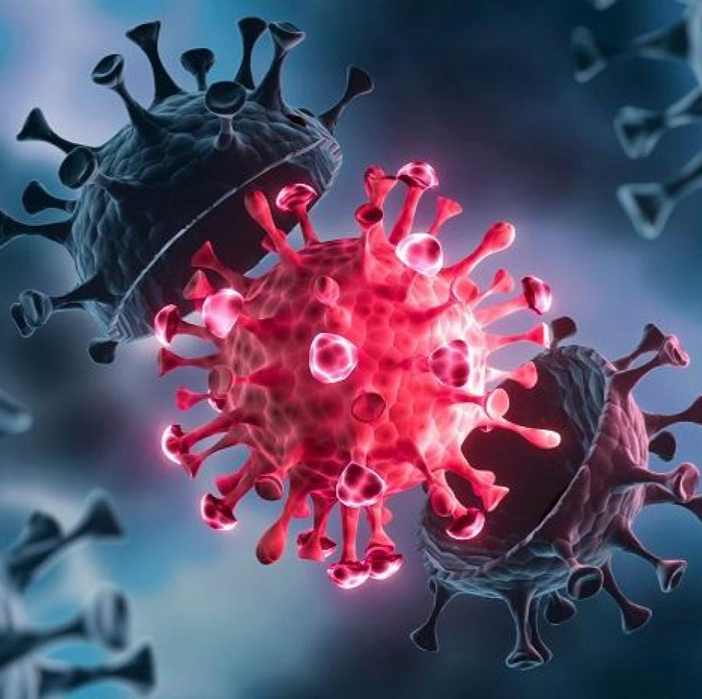
Covid-Predictor (CP) Healthy, Wealthy
Co Founders
Fayazuddin, Md – U01031155
Lalith, Banala – U01035260
Rushitha Reddy, Sana – U01032105
Krithi Reddy, Nareddy – U01034369
Manikanta, Rokkam – U01038113
Target Markets: World Health Organization (WHO), USA government (Health Department) and Corporate Individuals

Slide 2
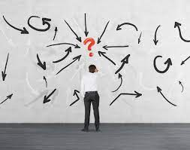
What is the PROBLEM?
Since the World Health Organization declared Covid 19 a pandemic in March 2020, it has caused several devastating effects on the world's population, collapse of nations economies, collapse of businesses, loss of job opportunities, conflicts among family members, are others of those suffering from the virus, and many more.
It has been harder to predict the prevalence occurrence of this virus at any particular time and place and the next location where its severity will be witnessed.
Scientifically, it has proven futile to predict which next place and time this virus will be most witnessed especially after being detected in a given place.

Slide 3

Our SOLUTION
We are working on building a model that will be able to predict where the virus will have a greater prevalence in comparison with its immediate predecessor(s).
Artificial Intelligence (AI) along with in order to collect virus information, drones will be used.
Drones are part of a distributed computing technique, and the information gathered by them shall assist in the development of AI. machine learning will help achieve this. Python SDK will be used in coding.
Social media platforms will also be used to gather information from relevant individuals that would help populate future prediction patterns

Slide 4

Market Research Justification
Currently, there are no available apps on covid 19 predictability pattern.
The available research findings and outputs have been based on contact tracing and the assumption that a place with so many contacts traced might witness higher prevalence than the rest.
However, there are other predict models in other sectors like weather, animal and crop production, etc.
This app can be used by all groups of people. The covid-19 predictor is expected to be of suffice to all groups of people since coronavirus does not choose on whom to infect.
The app shall be able to submit its information to various authorized agencies within the health ministry irrespective of the user.
An all-time available connectivity, therefore, the app can be found and used at any time.

Slide 5

Unique Features
Data collected from different quotas of the research niche
Use of python SDK to develop and implement the app
Embedding of voice command & control sensors onto the application
Embedding of GPS onto the app to help in location identification
Hosting of the app by cloud base services hosting companies that guarantees all all-time uptime
Direct configuration to the health agencies server through embedding the server’s IP address onto the app

Slide 6

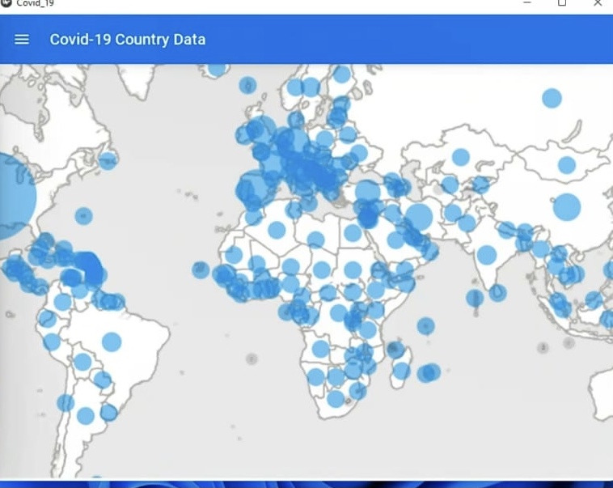
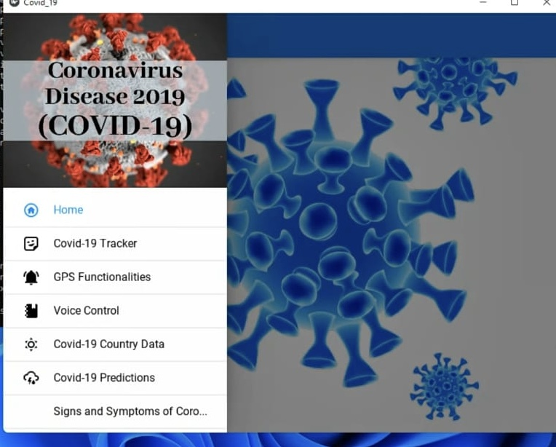
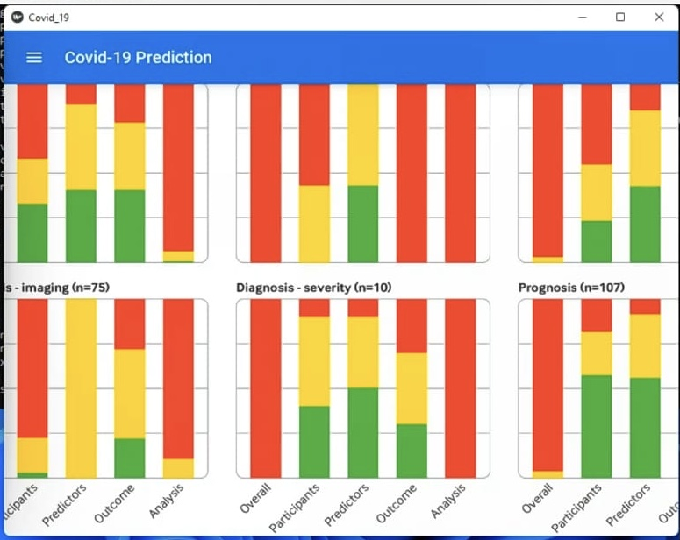
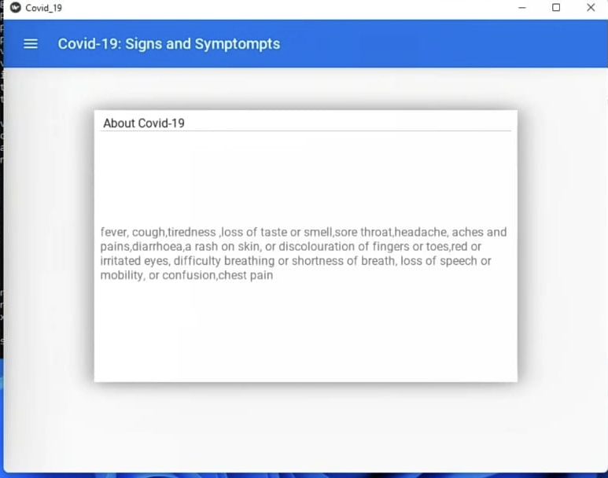
Key Features

Slide 7
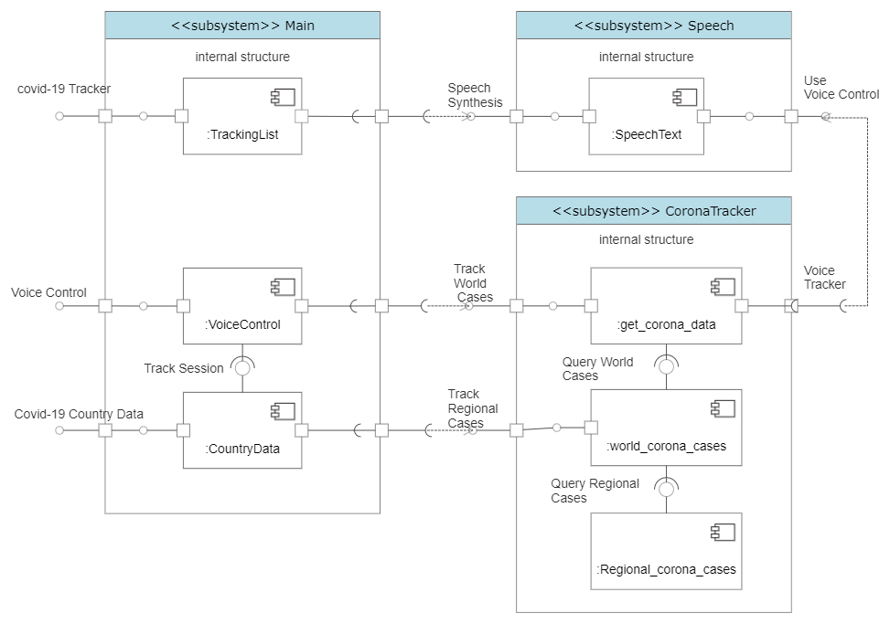
Design

Slide 8
Business Model
Key Partners | Value Proposition
Private transport businesses. All local restaurants.. Health care investors. World Health | View the app through voice control. Unlimited access to updated data. No commercials. Various trackers/dashboards.
Channels | Key Resources
Word of mouth. Any device. Use of all the available media platforms for marketing. | Employees. Python/Java SDK Platform. Windows Server 2020.
How Do We Make Money?
We Would ask Travel Agencies to subscribe to us to get notified about the regular updates on new variant. Linkages with other partners like WHO , USA Govt.

Slide 9
Team’s Contributions
Team Member | Areas of Expertise | Contributions Made
Fayazuddin Mohammed & Manikanta, Rokkam | Python , AI , Machine Learning | Coding, social media monitoring
Lalith Banala | Database, Programming | Analyzing & classifying data collected, coding
Rushitha Reddy Sana | Networks | Configurations of networks and network devices used
Krithi Reddy Nareddy | Biomed Computing | Research on corona virus

Slide 10
APPROACH
Activity | Duration
Planning and system design | 2 months
Model Development | 2 months
Model technical validation | 1 month
User Testing | 1 month
Gaining Market Entry | 1 month
Scale up and recommendations | Infinite

